Slide 1
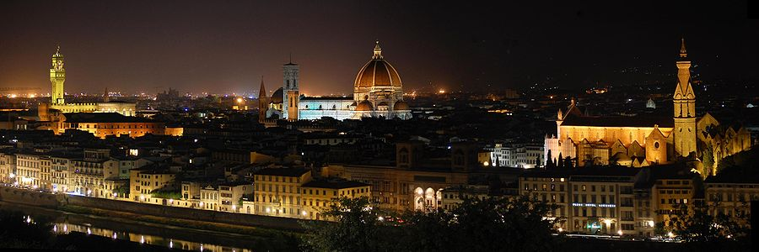
HUMN 251
Introduction
This Photo by Unknown Author is licensed under CC BY-SA

Slide 2

On Your Notecards
Name
1) A belief you hold (e.g., ‘I find Microsoft products to be overly cumbersome’)
2) Another belief you hold (e.g., ‘The Quarterdeck will serve Tacos tomorrow’)
This Photo by Unknown Author is licensed under CC BY

Slide 3

Flip the notecard (Don’t let your neighbors see either side of card…)
Write one or two reasons for having the beliefs that you put on the other side.
This Photo by Unknown Author is licensed under CC BY

Slide 4
Pair up. Show your neighbor your ‘reasons side’ of the card.
See if the other person can guess your belief based on your reason side.

Slide 5
What are the Humanities?

Slide 6
How can I do well in this course?
The syllabus
Moodle Resources and Assignments
The Book
Come to class

Slide 7
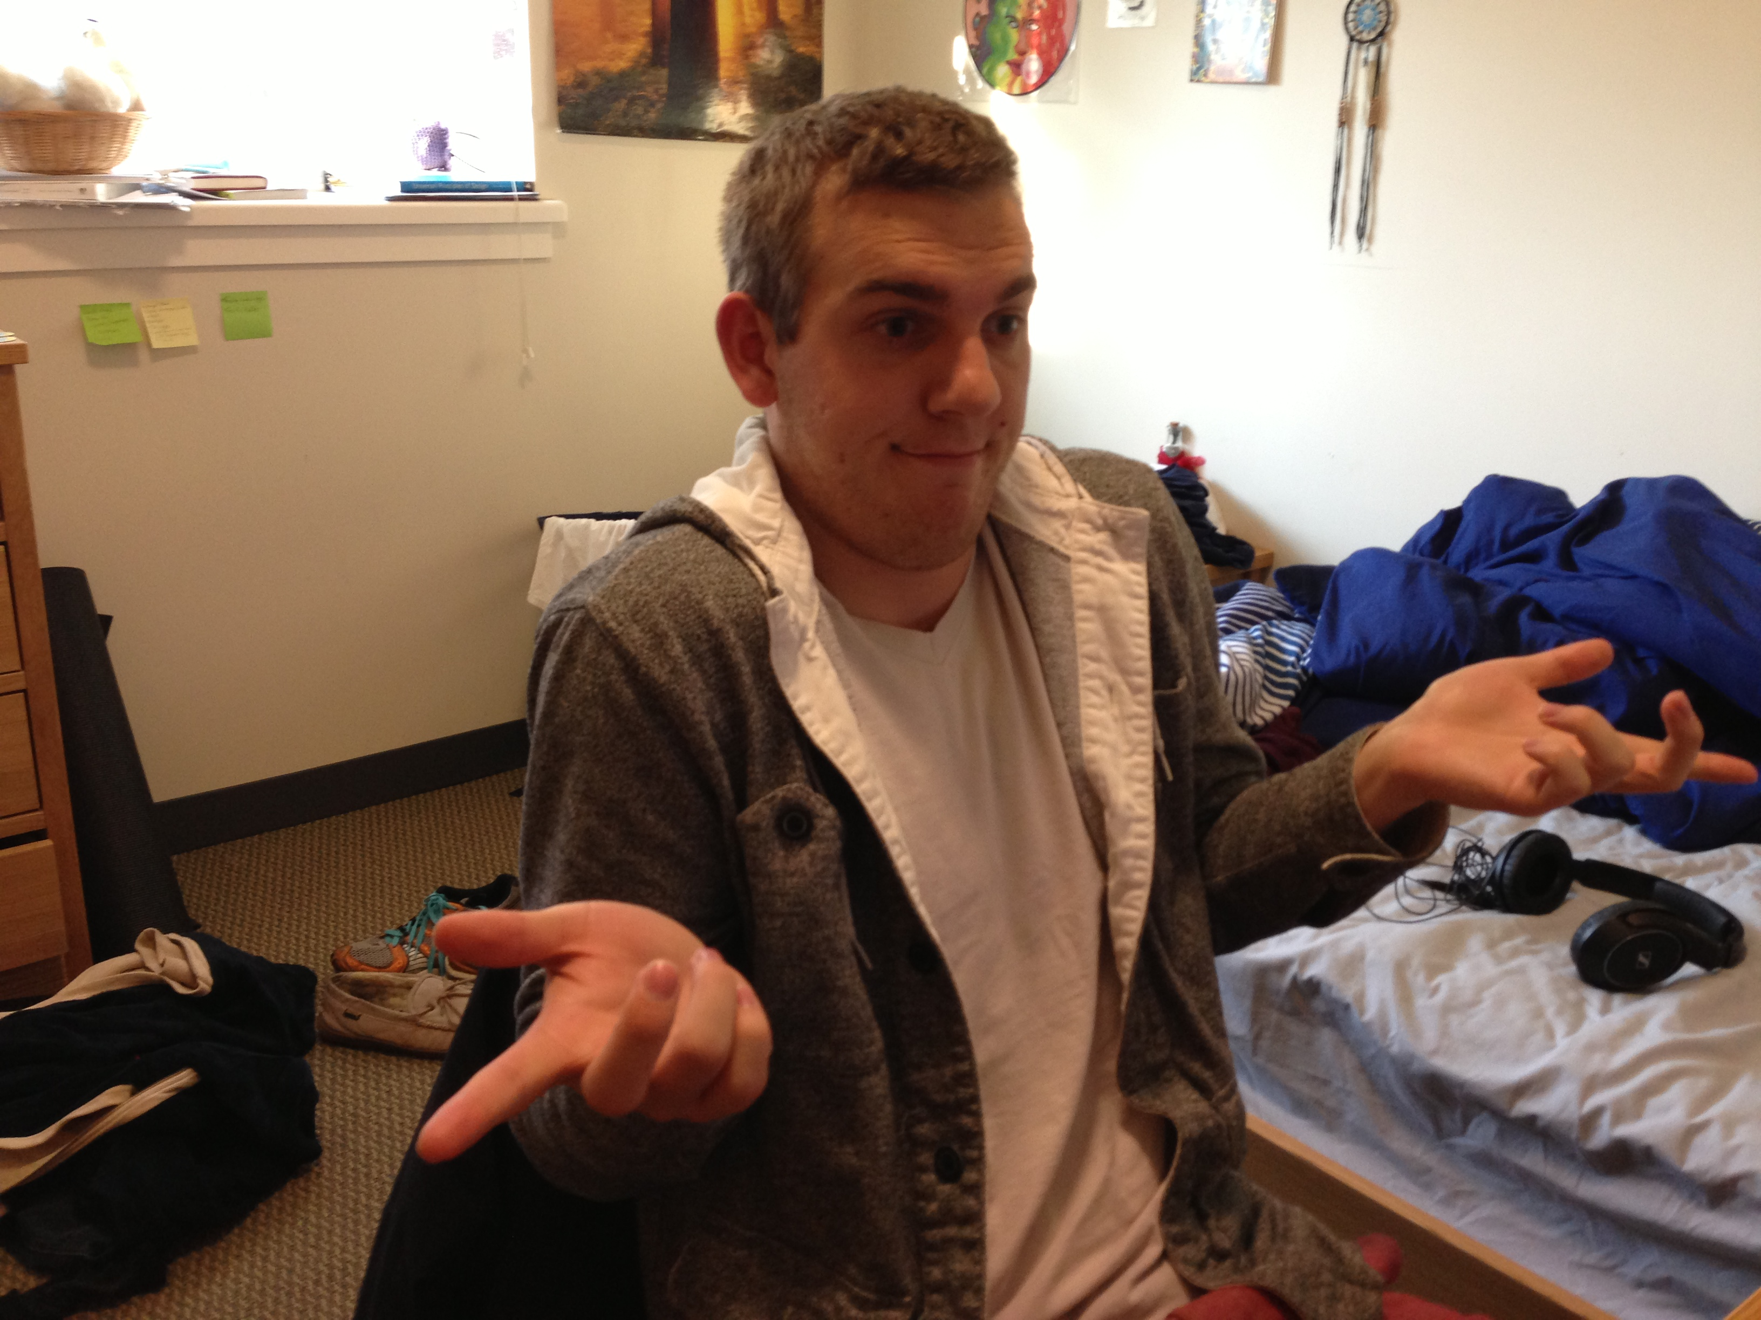
What makes us human?
Ask a friend, tell a friend
This Photo by Unknown Author is licensed under CC BY-SA-NC

Slide 8
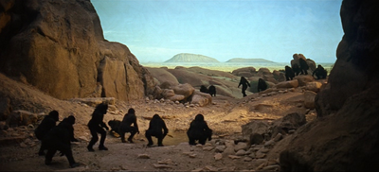
What does 2001: A Space Odyssey tell us about who we are?
This Photo by Unknown Author is licensed under CC BY-SA-NC
https://www.youtube.com/watch?v=ypEaGQb6dJk

Slide 9
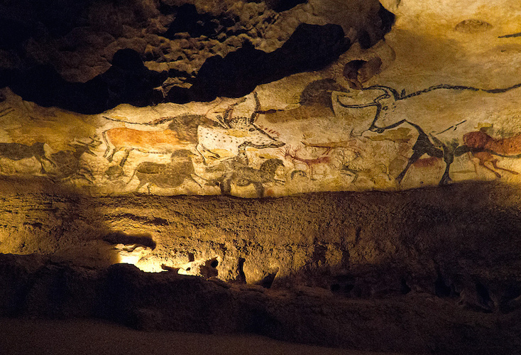
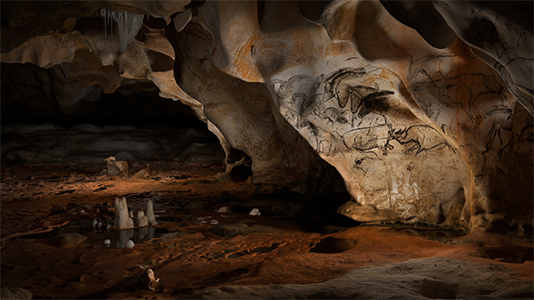
What do cave paintings tell us about who we are?
https://drive.google.com/file/d/0Bzsb9k50mY6mclBYS05qNTFwNEk/view?usp=sharing
This Photo by Unknown Author is licensed under CC BY
This Photo by Unknown Author is licensed under CC BY-SA-NC

Slide 10
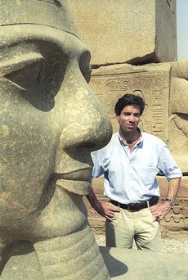

Why do humans make art? Why are humans drawn to art?
How Art Made The World
Nigel Spivey ——-—-————————-———→
https://drive.google.com/file/d/0Bzsb9k50mY6maUJ3c1dKcnA0ME0/view?usp=sharing
This Photo by Unknown Author is licensed under CC BY-NC-ND
This Photo by Unknown Author is licensed under CC BY-SA-NC

Slide 11
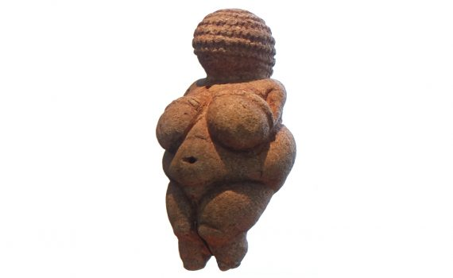
Why was this created? Why are we drawn to it? (according to VS Ramachandran and Nigel Spivey…)
Figure 0.4 “Venus” of Willendorf, from Lower Austria, ca. 25,000–20,000 B.C.E. Limestone, height 43⁄8 in.

Slide 12
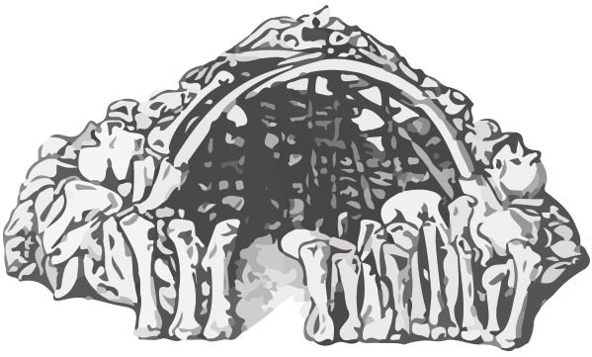
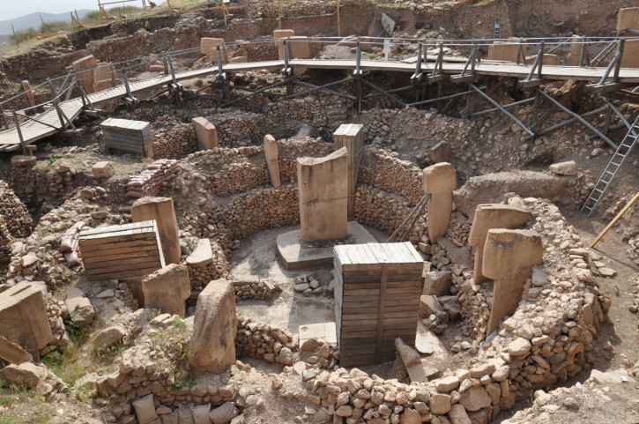
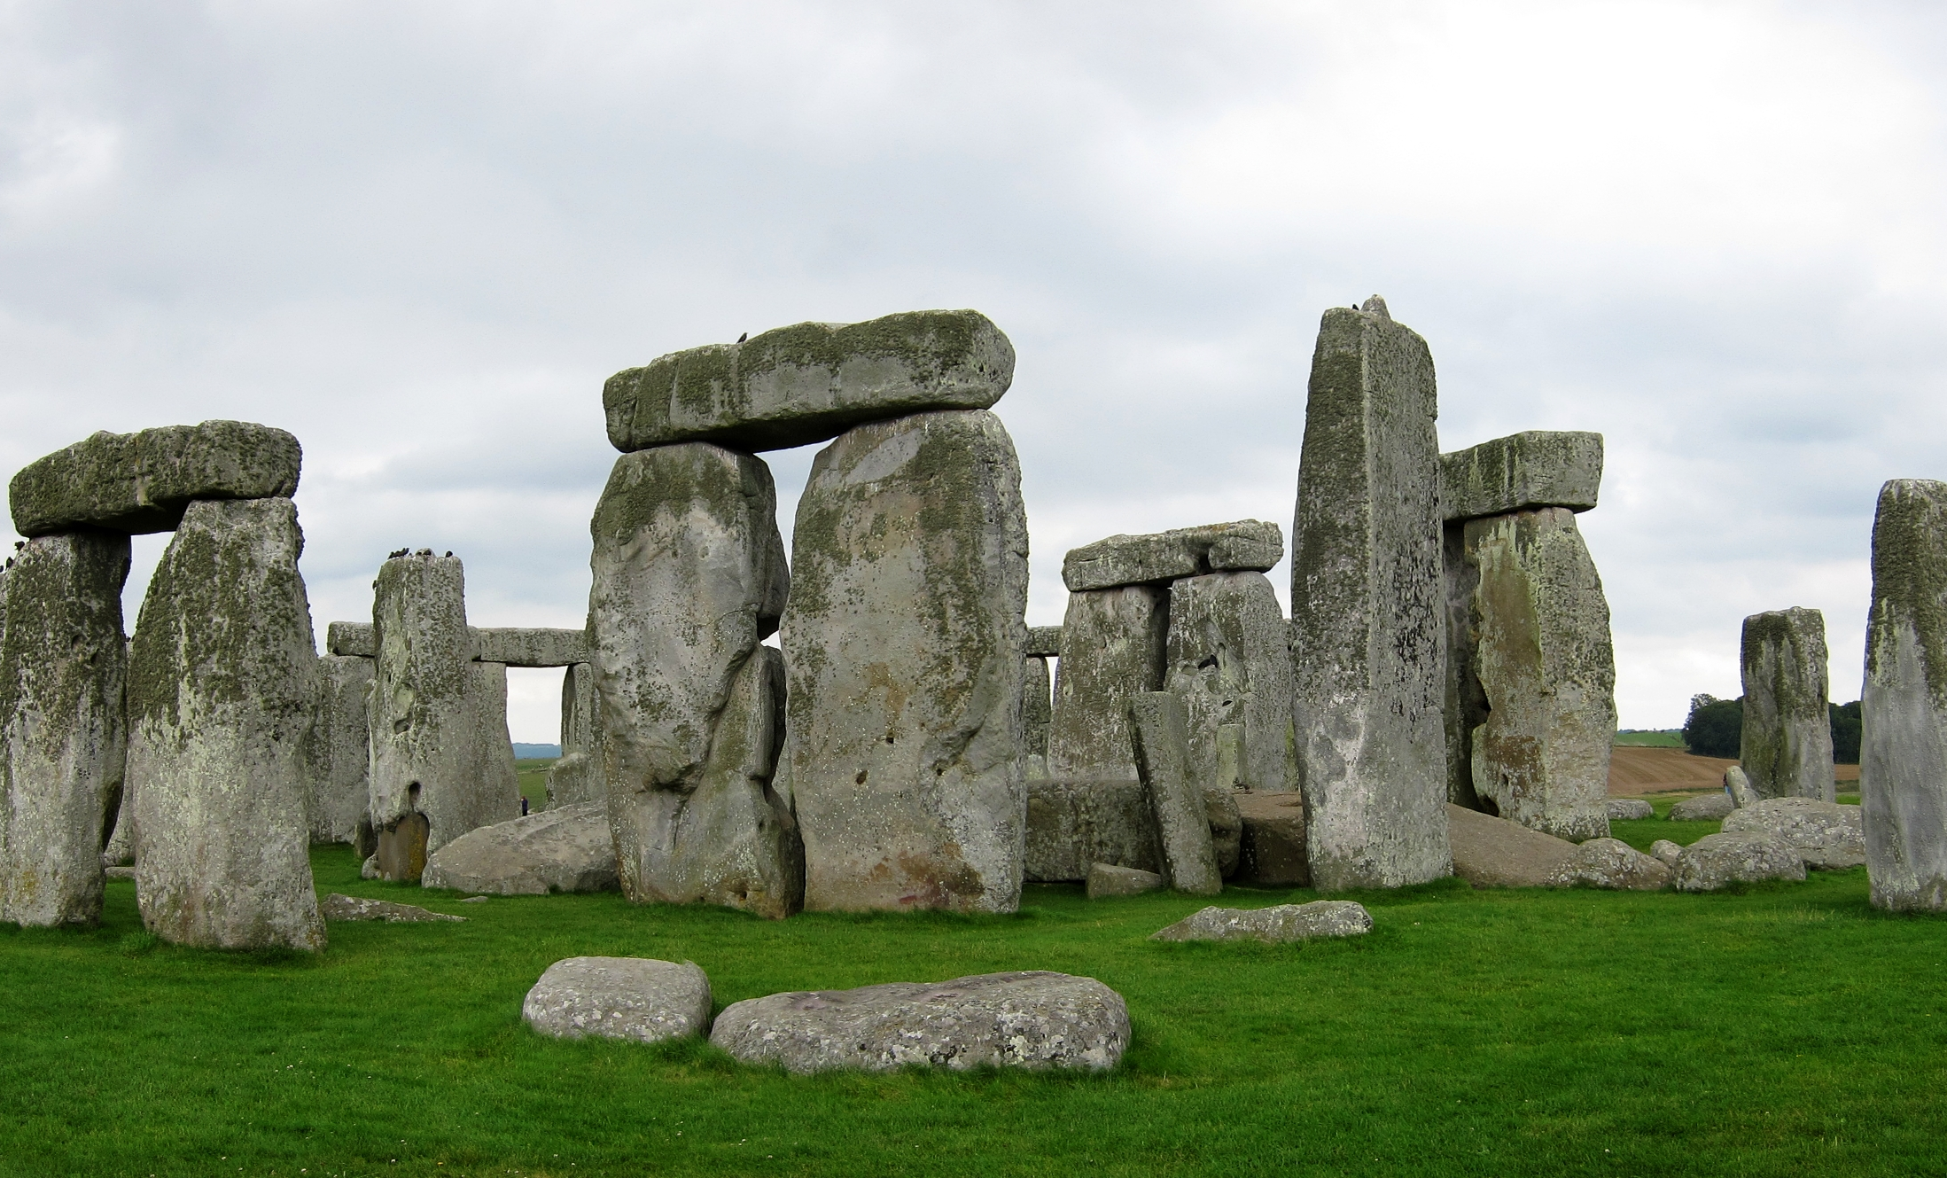
Structures in early human life?
Mammoth Bone House
Stonehenge (Neolithic)
Gobleki Tepe
Post and lintel architecture
This Photo by Unknown Author is licensed under CC BY-SA
Goblecki Tepe
This Photo by Unknown Author is licensed under CC BY-SA

Slide 13
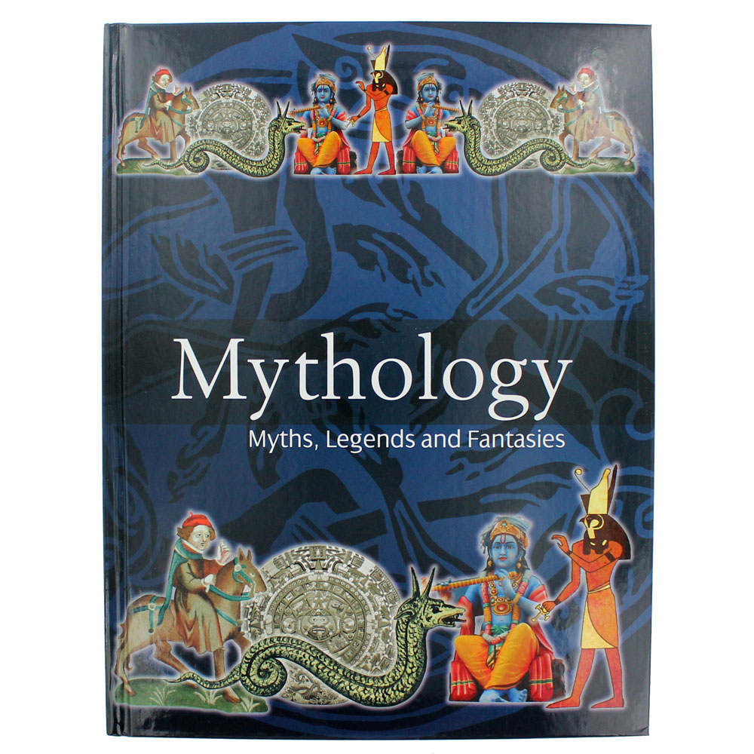
Creation Myths
Describe the origins of the cosmos, according to the Rig Veda (India)
How does the Mohawk creation myth discuss the divergence in race?
What do you think is the importance of naming in the African creation myth?

