Slide 1
GEOG 108: Meteorology and Climatology
Week 6: 09/30-10/04
GOES- Geostationary Operational Environmental Satellite
Images and Cloud Type Interpretation

Slide 2
Read page 124-140 from chapter 5 of your textbook
  These pages are about:
    Clouds
    Cloud classification and identification
    Cloud observation and
    Satellite Observation

Slide 3
Satellite Observations
Under the topic satellite observations, use of GOES in cloud identification is presented.

Slide 4
Satellite Activity
Instructions:
Go to the GOES image viewer website below:
https://www.star.nesdis.noaa.gov/goes/index.php
From the left panel, choose Tropical Atlantic Region.
On the next page, you will see several images, animation loop, and animated GIF of GOES east-sector view: Tropical Atlantic
  One animated GIF of GeoColor is presented on next slide for you to view.
  As the image says on website, the daytime is true color image and nighttime is multispectral infrared image.

Slide 5
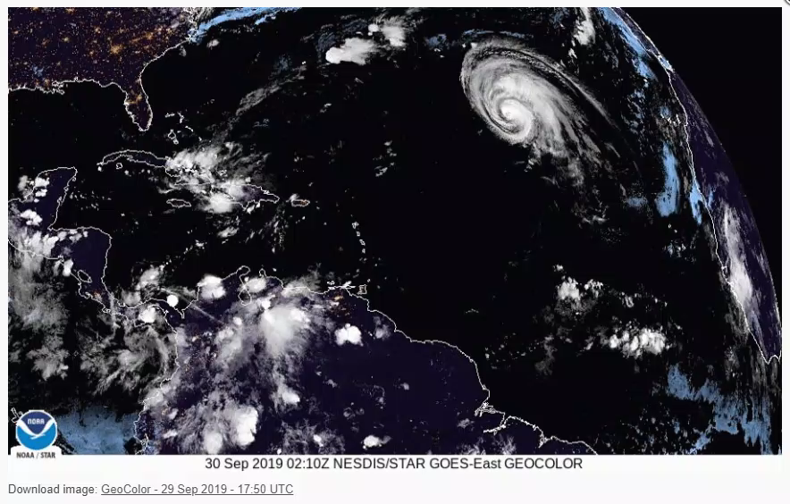
Thick cloud
Thin cloud

Slide 6
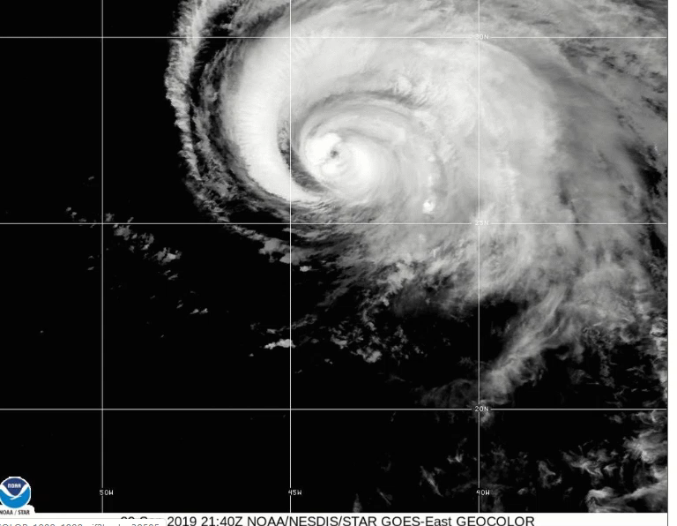
Animated GIF of GOES-East GEOCOLOR similar to the one on figure 5.35 from your textbook for Hurricane Lorenzo

Slide 7

Questions:
(Initial Post- 7 points, Feedback – 3 points)
Use the play button on the bottom of the animated GIF –the first one to detect and describe how colors of the thin and thick clouds vary between true color (day) and infrared images (night).
Now view one animated GIF of the GeoColor image of your selected time (note the local time from top-left part of the window) as given in example: Take a screenshot of the image to put on your power point (or download if you are attaching an image on your forum post) and locate (show them using pointer lines) various cloud types similar to the one in example.
Viewing band 11 (the cloud top IR) and the day-night variation of cloud color (from your answer 1),
  Further describe the nature (the height, temperature, cloud form, and any weather process associated) of these clouds? (hint: page 136 and 137 of your textbook).

